Slide 1
Cloud Storage
By –> Bhumit Patel
10ce16

Slide 2
Outlines
Introduction
Cloud storage Architecture
Type of Cloud storage
Features of Cloud storage
Video : Cloud storage use in study-work

Slide 3
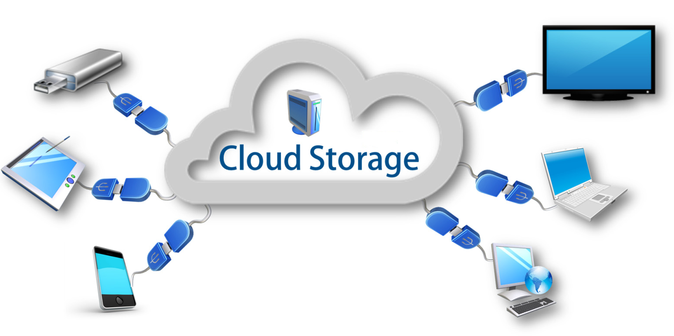
What is Cloud Storage?????
A Cloud storage is the model of networked online storage where data is stored on multiple systems.
A cloud storage offers limited/unlimited storage capacity over the Internet.

Slide 4
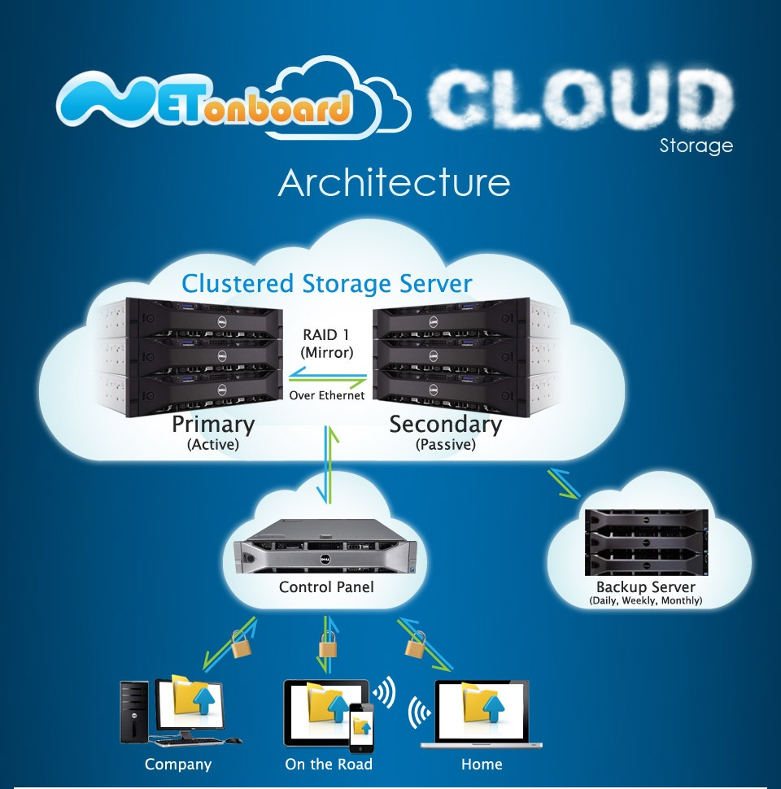
Cloud Storage Architecture
3
4
2
1

Slide 5
Type of Cloud storage
1. Public cloud
2. Private cloud
3. Hybrid cloud

Slide 6
Public cloud
Public cloud means ,a service provider makes resources, such as applications and storage, available to the general public over the Internet.
Public cloud services may be free or offered on a pay-per-usage model.
It is usually an open system that is available for free to general public via World Wide Web or Internet

Slide 7
Cont’d…..
The main benefits of using a public cloud are:-
-> Public cloud solution is typically very simple and immediate.
-> No wasted resources because you pay for what you use.
Examples of public clouds:-
-> Amazon Elastic Compute Cloud (EC2),
-> IBM's Blue Cloud,
-> Sun Cloud.

Slide 8
Private cloud
Private cloud is the implementation of cloud services on resources that are dedicated to your organization, whether they exist on-premises or off-premises.
With a Private cloud, you get many of the benefits of public cloud computing—including self-service, scalability, and elasticity & with the additional control and customization available from dedicated resources.

Slide 9
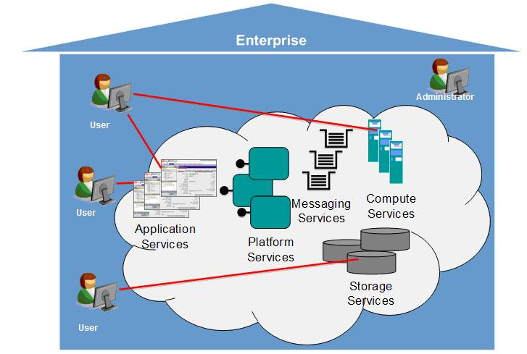
Cont’d…..
The reasons for using a Private cloud are
cost reduction,
enhancing service quality,
more importantly for reducing the time it takes to deliver what users demand.

Slide 10
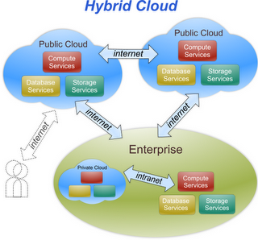
Hybrid cloud
Hybrid cloud is a combination of characteristics of both public and private cloud where internal and external service delivery methods are integrated.
A Hybrid cloud is a composition of at least one private cloud and at least one public cloud.

Slide 11
Cont’d…..
Benefits of using a hybrid cloud :-
-> Hybrid clouds offer the cost and scale benefits of
public clouds while also offering the security
and control of private clouds.
-> Cost Savings ,
-> Business Agility ,
-> Data migration , etc….

Slide 12
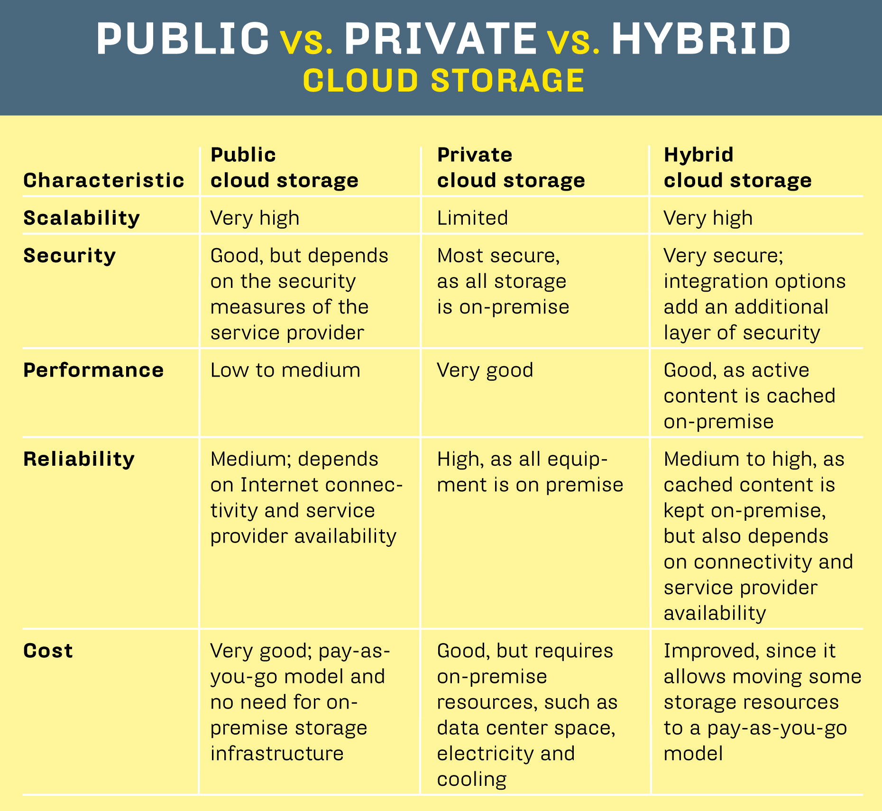

Slide 13
Features of Cloud storage
Ability to pay as you grow, so you only pay for what you use
Unlimited free customer support
Control your data and storage costs
Ability to store data copies in multiple datacenters
It's scalable, reliable and easy to administer
Portability - Since everything is stored on a remote server, it can be accessed anywhere via the internet.

Slide 14
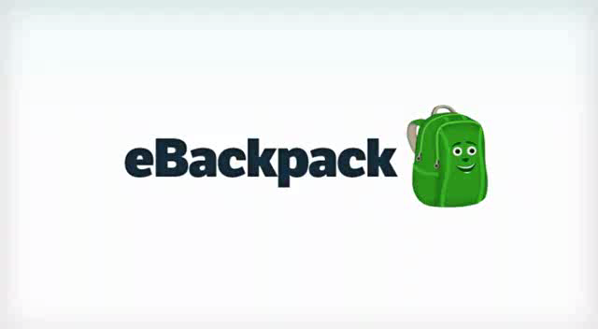

Slide 15
References
http://en.wikipedia.org/wiki/Cloud_storage
http://www.arsys.net/cloud-hosting/cloudstorage-advantages.html
http://www.nec.com/en/global/solutions/cloud/whitepaper/pdf/storage.pdf
https://www.ibm.com/developerworks/mydeveloperworks/blogs/c2028fdc-41fe-4493-8257-33a59069fa04/entry/september_19_2010_1_45_pm7?lang=en

Slide 16


